Slide 1
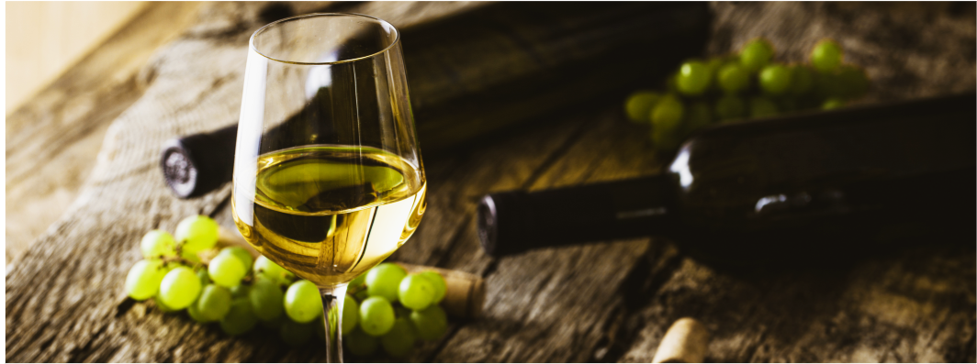
Wine Quality Analysis
By: H.Syed, M. Valenzuela, B. Sosa, G. McDaniel

Slide 2
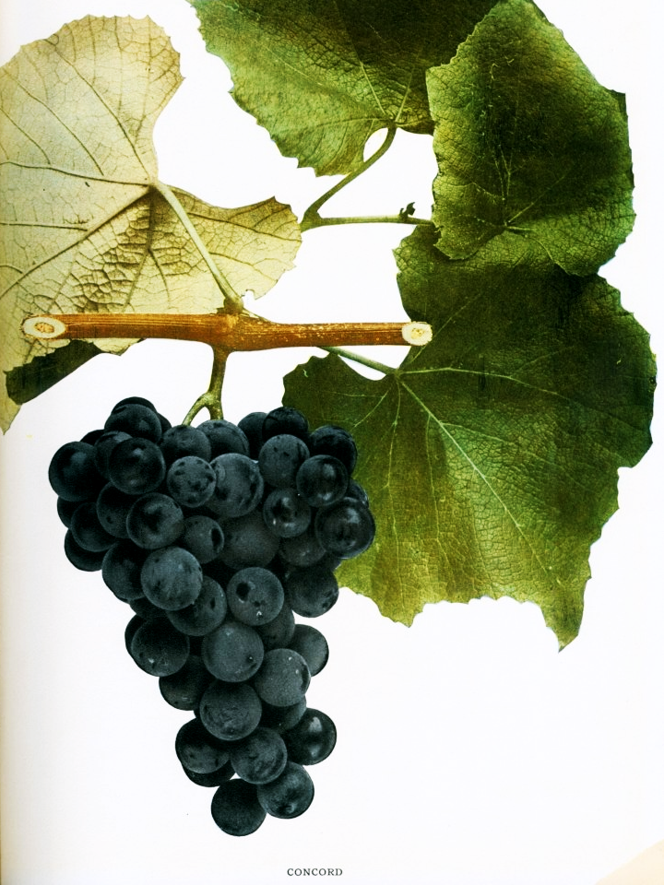
Wine Quality of Vinho Verde in Portugal
Why we picked this topic:
As a team, we were all interested in learning more about the attributes that determine the quality of wine. Different characteristics of wines can be influenced by the environment, region and soils wine grapes are grown in. We would like to isolate which variables are associated to high and low quality wines. A machine learning model will be composed to ingest the 11 characteristics to provide a quality score.
Description of the data source:
The two datasets are related to red and white variants of the Portuguese "Vinho Verde" wine. It displays 11 different characteristics of the grape variety.
Source Data: https://archive.ics.uci.edu/ml/datasets/Wine+Quality

Slide 3
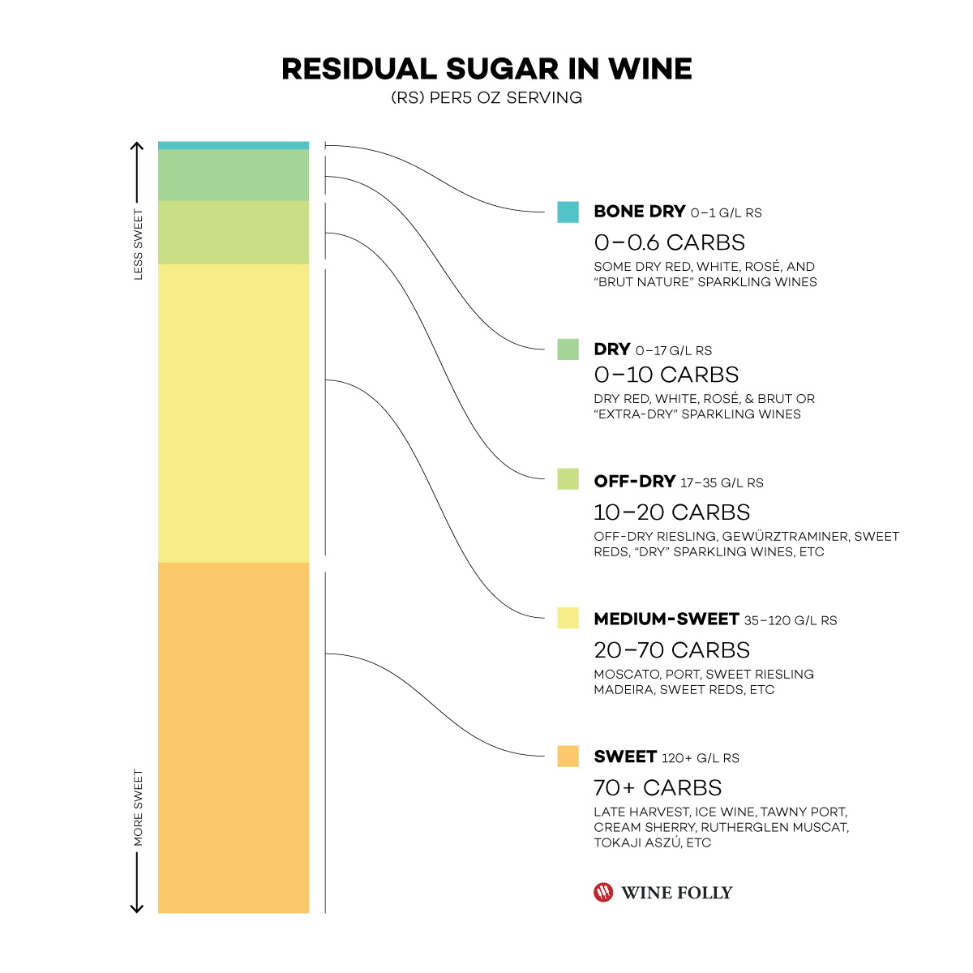
Questions We Hope to Answer
What are the top five high quality wines?
What are the bottom five lowest quality wines?
How many wines have residual sugars above 10? (Off-Dry)
How many wines have residual sugars less than 0? (Bone-Dry)
How many wines have residual sugars higher than 20? (Medium-Sweet)
How many wines have an alcohol level greater than 15%?
How many wines have an alcohol level less than 11%?
How does each individual chemical property impact the overall quality score of wine?
[Will replace with our dryness scale from Tableau]

Slide 4
Machine
Learning
Model
Using a supervised learning model, the independent variable (x) would be:
Fixed acidity
Volatile acidity
Citric acid
Residual sugar
Chlorides
Free sulfur dioxide
Total sulfur dioxide
Density
pH
Sulphates
Alcohol
The dependent variable (y) is 12 - quality (score between 0 and 10). Using sklearn we will split the testing and training data. We will use the training data to train the model and then use the testing data to see the results using the predict method. Then we will compare the testing and training outcomes to see if the model can accurately predict the wine quality score.

Slide 5
Technologies Used
Data Cleaning and Analysis:
Pandas will be used to clean the data and perform analysis.
Database Storage:
Postgres SQL is the database we selected to use to store the cleaned data
Machine Learning:
SciKit learn is the Machine Learning library for Python that we will use to make predictions on for our wine analysis for our project.
Dashboard:
We have selected Tableau to build the dashboard to present our results.

Slide 6
Impacting Variables
Alcohol
Residual (sweet vs dry)
Acidity - wines that lack fixed acidity are ‘1-dimensional / flat’*
Free - higher
Fixed (citric acid) - lower amounts may indicate spoilage
Sulfur Dioxide
Chlorides
Notes:
https://towardsdatascience.com/what-makes-a-wine-good-ea370601a8e4

Slide 7
Dashboard Details
Tools:
Tableau - we will be using tableau for our data analysis visualization dashboard.
CSV Raw Data Files - our data will be imported via csv files to utilize in our development of various interactive graphs and charts.
Machine Learning Output - the machine learning output will be saved as a csv file and imported into Tableau.
Interactive Element:
Scale Diagram - this will be a diagram comparing how residual sugar levels provide to the sweetness vs dryness of a wine.
Line/Bar Graph - to show how certain chemicals properties contribute to the quality of wines.
For example, when you take out alcohol what is the quality score versus when you include alcohol?
Notes:
https://towardsdatascience.com/what-makes-a-wine-good-ea370601a8e4

Slide 8
Rubric Outline (Segment II)
Selected topic
Reason topic was selected
Description of the source of data
Questions the team hopes to answer with the data
Description of the data exploration phase of the project
Description of the analysis phase of the project

